Slide 1

“History and Overview of the HCV Elimination Program”
Minister Of Labour Health and Social Affairs of Georgia
Dr. David Sergeenko

Slide 2

Hepatitis C under the Global Fund project free of Charge Hepatitis C treatment with Peg/Riba regimens for HIV/HCV co-infected patients with Peg/Riba
Free of Charge Hepatitis C treatment with Peg/Riba regimens for prisoners.
10 000 Patients from civil sector were offered a 60% discount for medicines (Peg/Riba)
We began negotiations with US CDC, Gilead Sciences, Inc and other US partners
1st National Workshop on Hepatitis C, March 12-14, 2014
National Committee for HCV elimination program was established

Slide 3

Infection control and prevention policy documents and guidelines were updated
Development of electronic program “Stop C”
Doctor trainings were conducted on updated protocols and guidelines
National workshop on Short /urgent measures of Hepatitis C elimination action plan
HCV elimination action plan was approved and state program launched

Slide 4

APRIL 21th
Memorandum of Understanding between Georgian Government and Gilead Sciences, Inc was signed

Slide 5

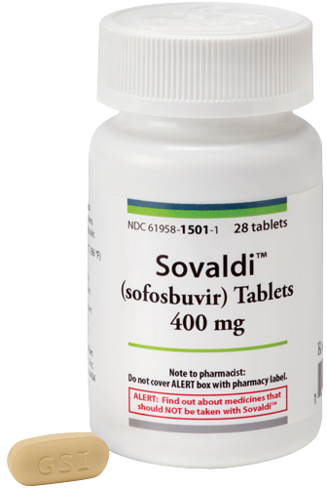
Large-scale PR campaigns have been launched with multi-sectorial approach and awareness rising in the population
Initially 4 provider clinics were selected and Committee specially dedicated for patient inclusion was created
On May 1 we’ve received first stock of “Sovaldi”

Slide 6
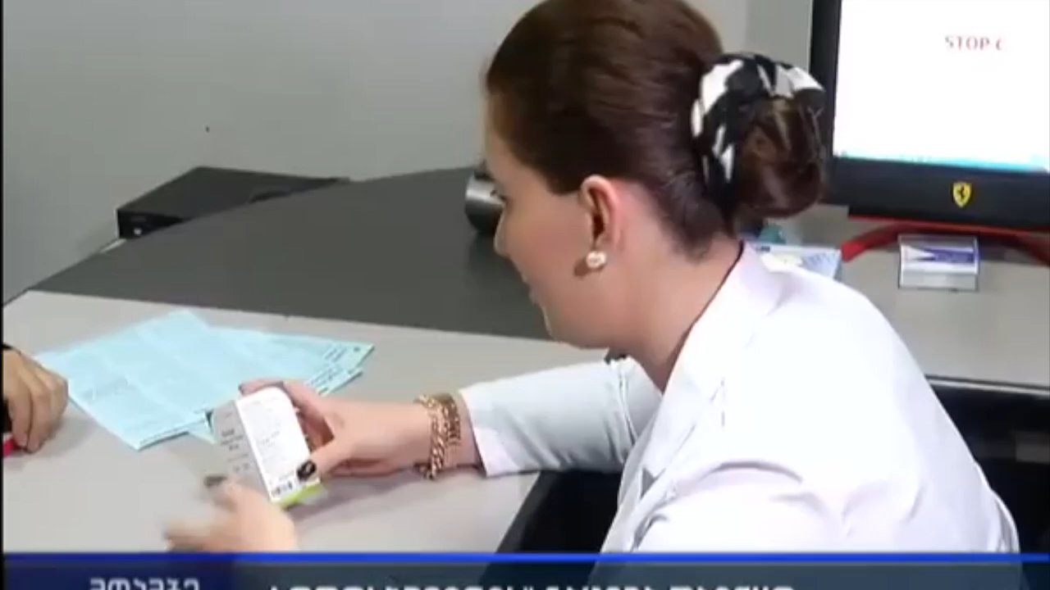
On May 15th may first patient received 1 pill of “Sovaldi”
The initial phase included the prioritizing of patients.
Free screening
US CDC published an article in the weekly magazine: “The Launch of a Hepatitis C Elimination Program in the Country of Georgia”

Slide 7



Project „ECHO” (Extension for Community Healthcare Outcomes) in the framework of L.I.F.E.R. (Liver institute and foundation for education and research) was implemented
External Hepatitis Technical Advisory Group (TAG), to meet in Tbilisi, Georgia, on 3-4, November
AASLD 2015 WHO symposium Georgia had presentation about hepatitis C elimination Program

Slide 8
Regulations oblige all inpatient institution to screen all hospitalized patients
Screening guidelines have been developed
Within updating new guidelines and considering new regimens committee members were trained by Gilead Sciences, Inc
Assessment of “Stop C” was performed

Slide 9

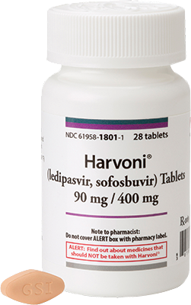
Gilead Sciences, Inc supported and approved Grant for development of new electronic program “Elimination C“
Update of treatment Guidelines
First stock of “Harvoni” received
Core antigen study protocol was approved and has been launched
National Serosurvey was completed

Slide 10
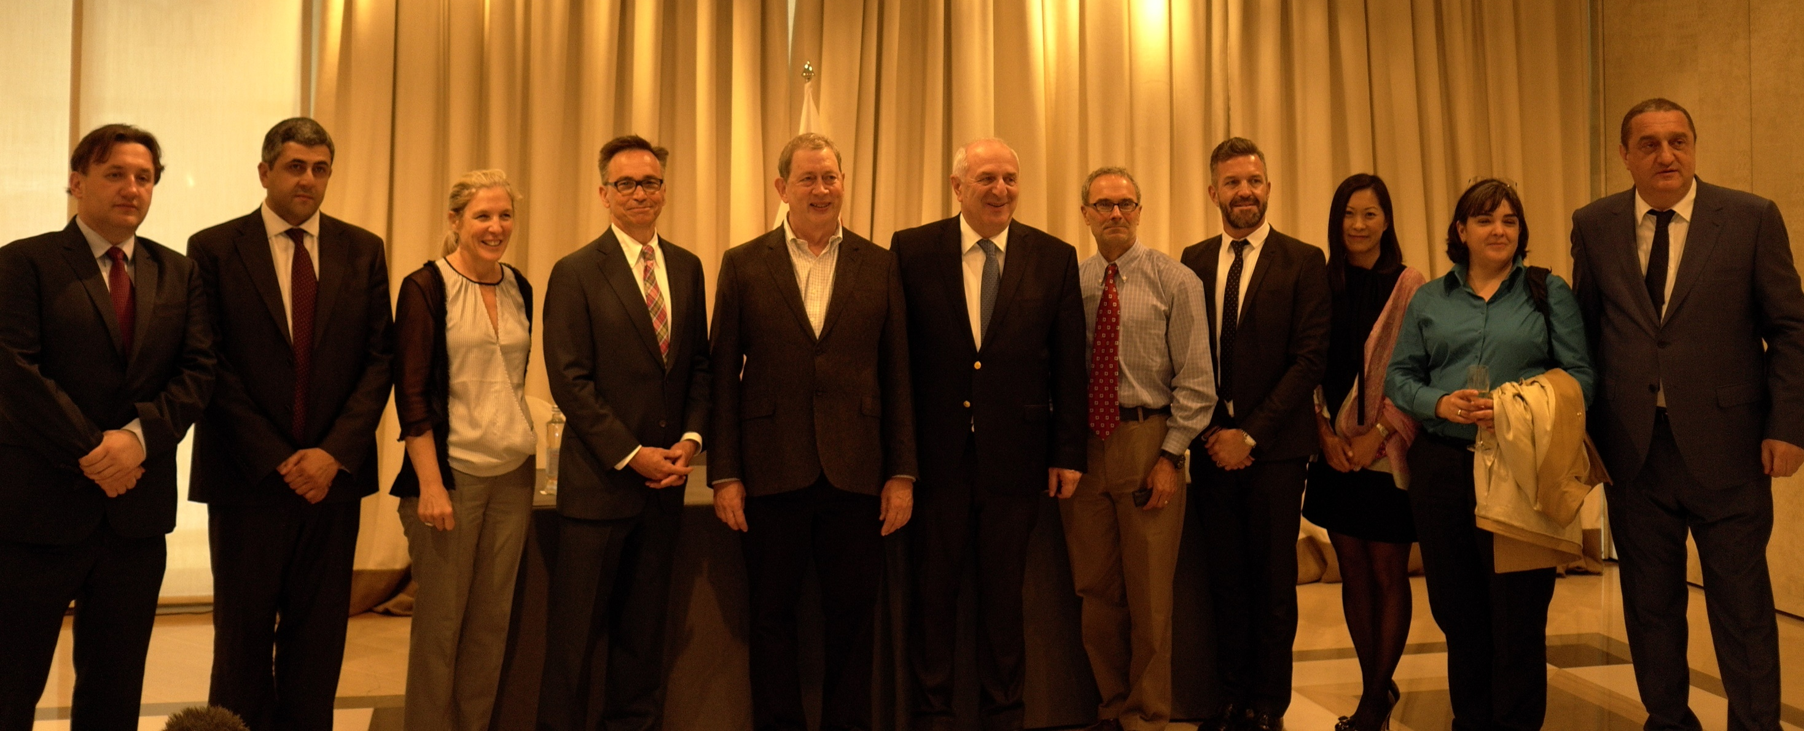
Clinical group was established
3rd National Workshop on HCV was held main objective was the summarizing of long-term elimination plan
April EASL conference and a side session for Georgia
Long term agreement between Company Gilead Sciences, Inc and Georgia Government was signed

Slide 11
June 10TH 2016
 | Stop C | Elimination C
Patients Steps | 6 | 7
Internal Process Time | 50-60 Days | 15-20 Days
Different Electronic Programs | 8 | 3
Max Persons on the Committee | 1099 | 2936
Max Persons on Committee Per Month | 1536 | 5073
Lifecycle | 14 Month | 10 Month
Patients Registered | 10750 | 23011
Average Per Month | 768 | 2301
Cost Effectiveness For 5 years | X | 1 200 000 Gel
New service center was for management was opened
New “Elimination С” program was launched
Eligibility criteria were removed

Slide 12
„ECHO” was implemented in local facilities
Symposium for National Guidance and Education By Lifer and Project “ECHO”
On august 18th long term action plan strategy was approved by government of Georgia
Second TAG meeting was held on October 24-25
Georgia HCV Elimination Scientific Committee was established.

Slide 13

MMWR National Progress toward Hepatitis C Elimination — Georgia, 2015–2016
CDC offered free external control schemes for laboratories
Gilead Sciences, Inc movie
4th National Hepatitis C Elimination Workshop
Opening of Zugdidi screening and management Center
Drug Distribution
Live Committee

Slide 14
Georgia’s HCV Elimination Program Treatment Database
(Apr 28, 2015 – Dec 31, 2016)
Screened | 470 000
HCV RNA + | 36 322
Started treatment | 27 595
Completed treatment | 19 778
Ongoing treatment | 7280
Not completed treatment | 537
Treatment outcomes - Sofosbuvir | 80 %
Treatment outcomes - Sofosbuvir/Ledipasvir | 98.2 %

Slide 15
Georgia’s HCV Elimination Program Service Providers

Slide 16

Future Goals
Negotiations are ongoing to attract partners in order to increase access to screening
Unified Screening database is under development and should be introduced shortly
Georgia HCV elimination website is under development
Strategy for inclusion of target Groups as PWID
Annual report is under development

Slide 17
Acknowledgements
Ministry of Labour, Health and Social Affairs
Gilead Sciences, Inc
US Centers for Disease Control and Prevention (CDC)
TAG Members
State, Clinical and scientific committee of Hepatitis C Elimination Program
Clinics

